Slide 1
Understanding Trends of Piracy in Major Shipping Lanes
Pirates of Monterey
Mary Grace Burke, Deryk Clary,
Michael Galvan, Julia MacDonald
Notes:
Understanding a Ship's Propensity to be Targeted by Piracy

Slide 2
Outline
Problem Framing
Data Curation
Data Cleaning
Natural Language Processing
Computational and Categorical Analysis
Data Frame Comparison
Lessons Learned and Future Work
Notes:
Problem Framing / Data Curation: (person)
What we were looking to find
The data we found and how disgusting it was when we got it straight from IMO
Challenges finding AIS data
Natural Language Processing: (Deryk)
I can talk about this for about 10 minutes
Geospatial Analysis (or whatever we end up doing): (person)
Pretty maps with overly assumptious word pictures.
Conclusions: (person)
Whatever we found
Don't allow people to write their own sentences in surveys

Slide 3

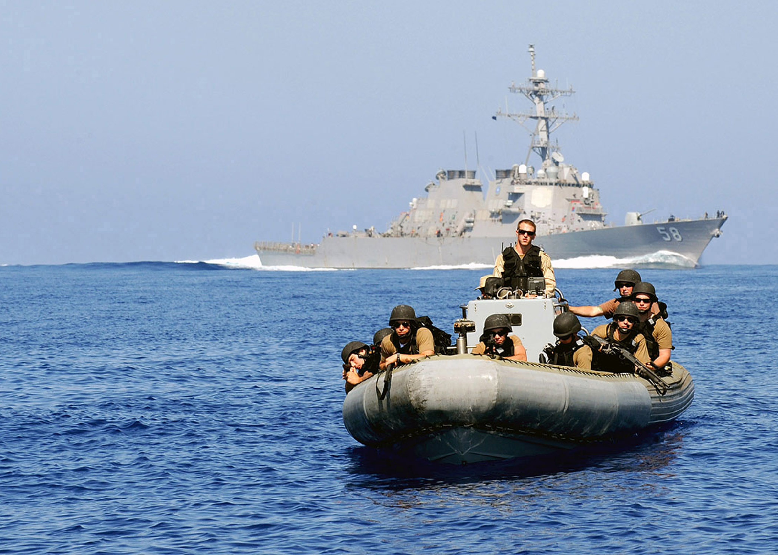


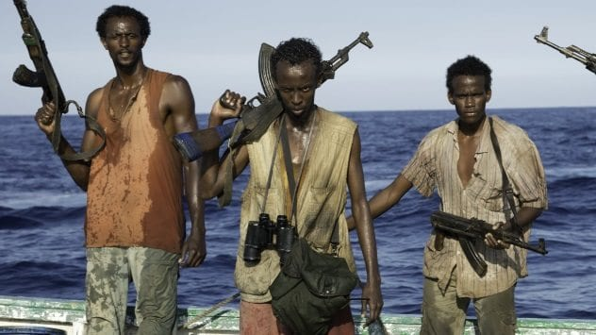
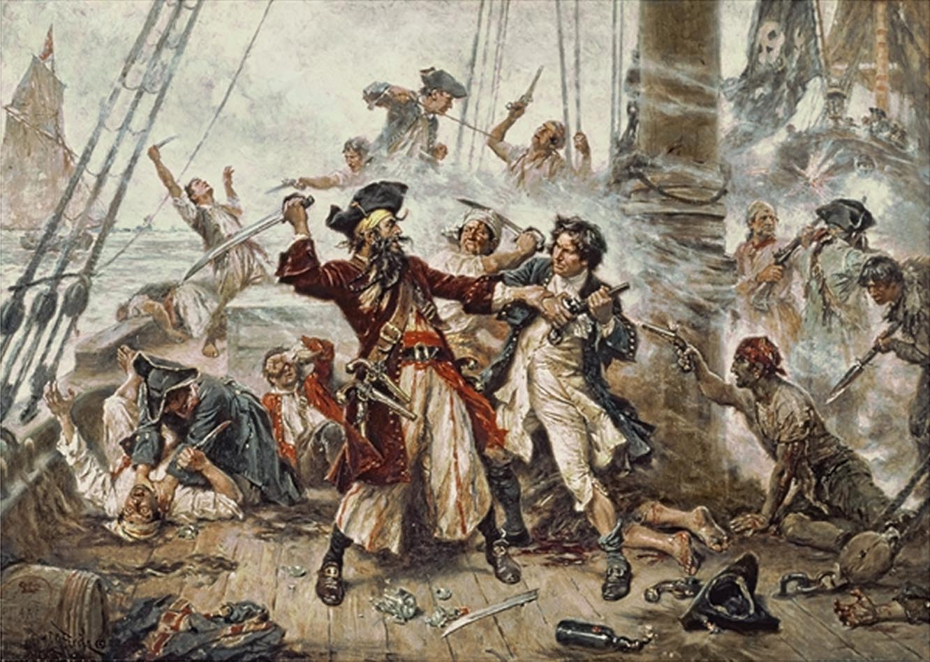
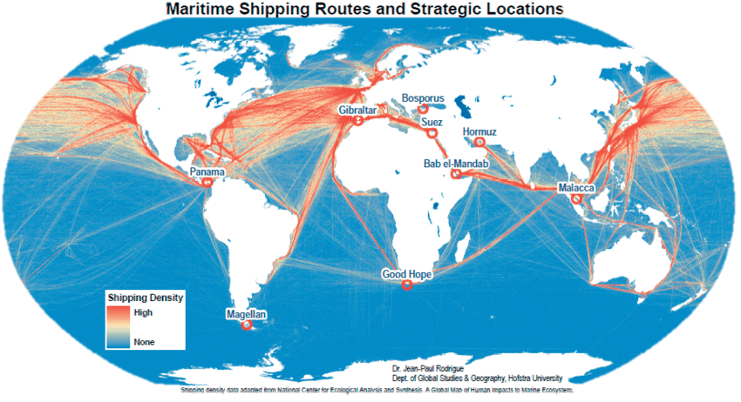
Problem Framing
“Piracy”:
Any illegal acts of violence or detention, or any act of depredation, committed for private ends by the crew or the passengers of a private ship or a private aircraft that occurs in international waters.
“Armed robbery at sea”:
When these actions take place within a state’s territorial waters.
Worldwide Effects:
The World Bank estimates piracy increases the cost of global trade by up to $18 billion annually.
Direct Costs:
Losses from attacks
Increased Shipping Costs
Insurance Premiums
Indirect Costs:
Disruption to Trade Routes
Regional Economies
Loss of Confidence
Military Intervention:
Hostage Rescue
Maritime Patrolling
Additional maritime mission set
Notes:
(Article 101 of the 1982 United Nations Convention on the Law of the Sea (UNCLOS) )

Slide 4
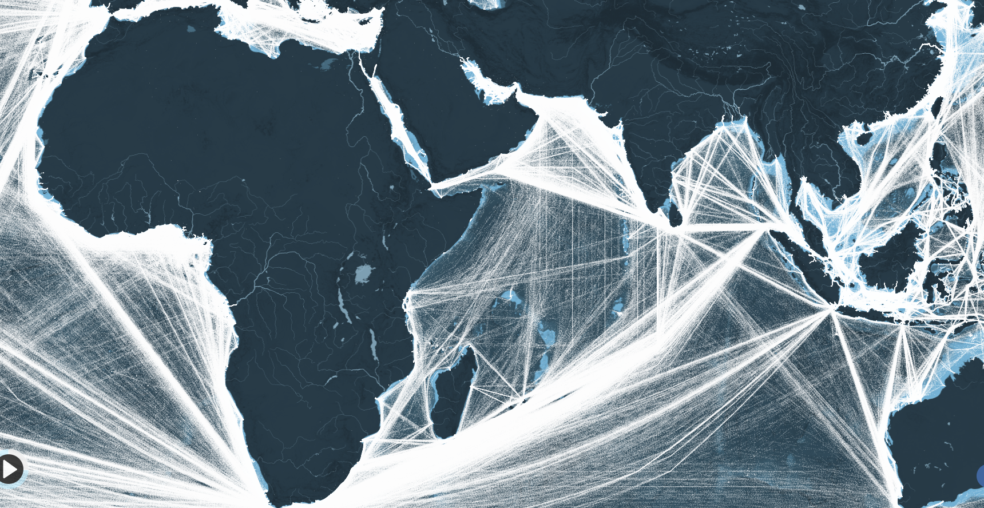
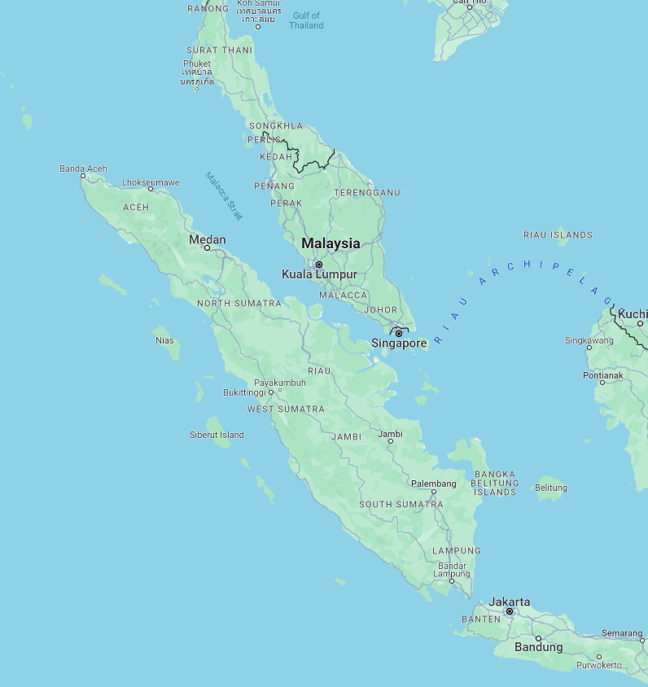
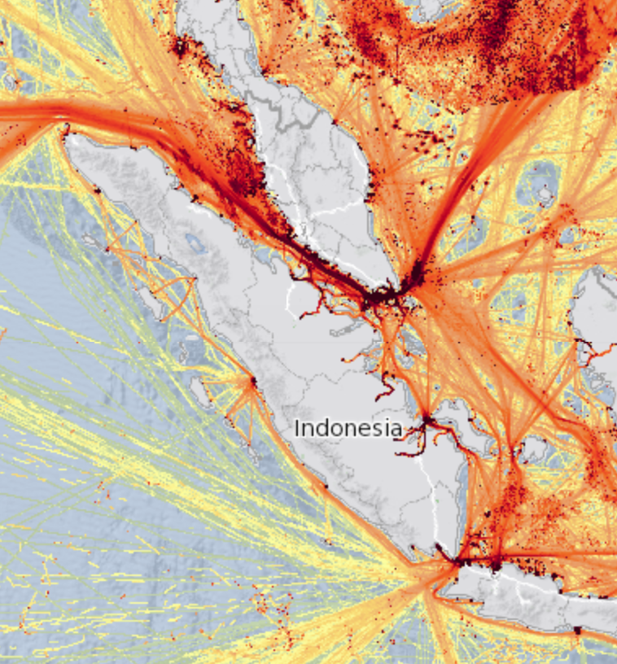
Problem Framing
Significance:
Critical gateway between Pacific and Indian Oceans
Trade Volume:
$3.5 trillion annually
30% of Worldwide Trade
94k+ Ships annually
Facts:
2/3 CHN Maritime Trade
80% CHN Oil Imports Transit
Strait of Malacca
N
N
100 NM
100 NM
Notes:
Image from: https://www.cambridge.org/core/journals/journal-of-navigation/article/abs/mapping-global-shipping-density-from-ais-data/AF6BE98CFFDE5D8E7C7466A708F4E7D1
https://www.marineinsight.com/environment/malacca-strait/
Sources:
https://www.ismworld.org/supply-management-news-and-reports/news-publications/inside-supply-management-magazine/blog/2023/2023-11/the-strait-of-malaccas-global-supply-chain-implications/#:~:text=The%20volume%20of%20trade%20that,third%20of%20all%20worldwide%20trade.

Slide 5
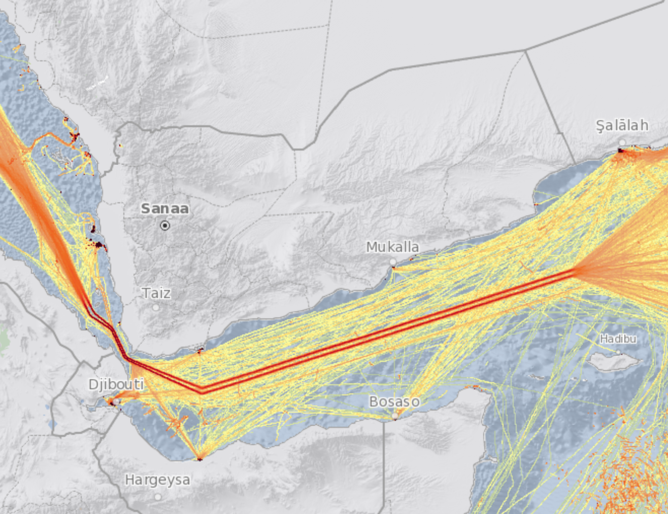
Problem Framing
Significance:
Entrance to the Red Sea, connecting Indian Ocean to Mediterranean
Trade Volume:
$1 trillion annually
12% of Worldwide Trade
20k+ Ships annually
Facts:
80% of trade European
~2,700 NM shorter than Cape of Good Hope route
Gulf of Aden
N
100 NM
Notes:
Image from: https://www.cambridge.org/core/journals/journal-of-navigation/article/abs/mapping-global-shipping-density-from-ais-data/AF6BE98CFFDE5D8E7C7466A708F4E7D1
https://www.spglobal.com/commodityinsights/en/market-insights/latest-news/shipping/122123-factbox-seaborne-trade-reroutes-away-from-red-sea-over-houthi-attacks
https://www.csis.org/analysis/transatlantic-approach-address-growing-maritime-insecurity-gulf-guinea

Slide 6
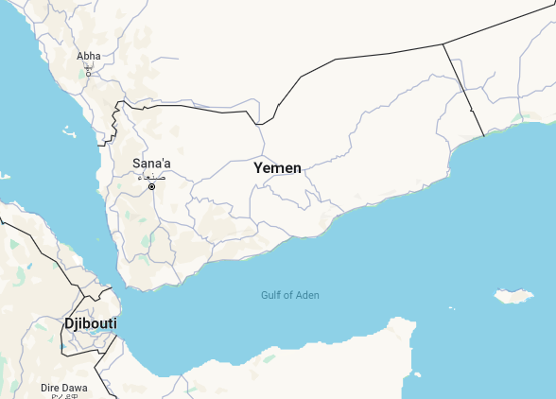
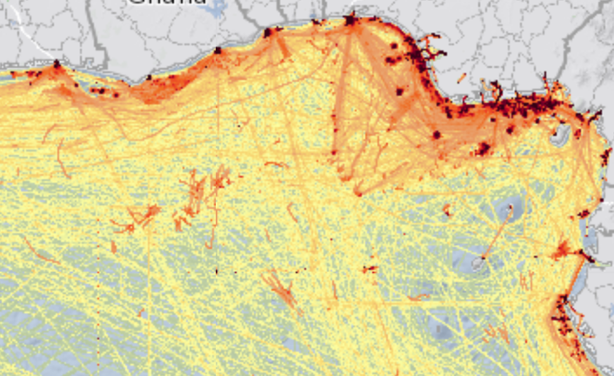
Problem Framing
Significance:
Main shipping zone for African Resources to rest of world
Trade Volume:
25% African Maritime traffic
1500 Ships daily
Facts :
Est $1.925 billion lost annually in direct and indirect costs due to piracy
Gulf of Guinea
N
6
100 NM
Notes:
https://www.securitycouncilreport.org/monthly-forecast/2022-11/gulf-of-guinea-piracy.php
Stable Seas estimated that ransom payments to Gulf of Guinea pirate gangs generated approximately $5 million annually.
https://www.scirp.org/journal/paperinformation?paperid=78135#:~:text=However%2C%20this%20region%20is%20riddled,on%20maritime%20transportation%20and%20security.

Slide 7
Problem Framing
Problem Statement:
What are the underlying trends concerning acts of piracy in major shipping lanes and could they lend insight into mitigating the risk to maritime traffic?

Slide 8


Data Curation
Reporting Agencies:
International Maritime Organization (IMO) (.pdf, .csv)
International Maritime Bureau (IMB): Maritime Security Piracy Reporting Center (.pdf)
Best Available Source: IMO AIS reports (.csv)
Poor Gary
 | “Dirty” | “Clean”
Date Range | JUL 1994 – JAN 2024 | JAN 2000 - DEC 2022
Dimensions | 8556 Rows / 16 Cols | 4814 Rows / 16 Cols
Notes | Missing Entries, Nonstandard textual entries (information dense) | Less missing entries, Parsed Data, Boolean Flags
Source | IMO.org | Data.world
vs
What other data is needed to analyze trends?
What methods produced the “clean” set and can we trust them?

Slide 9
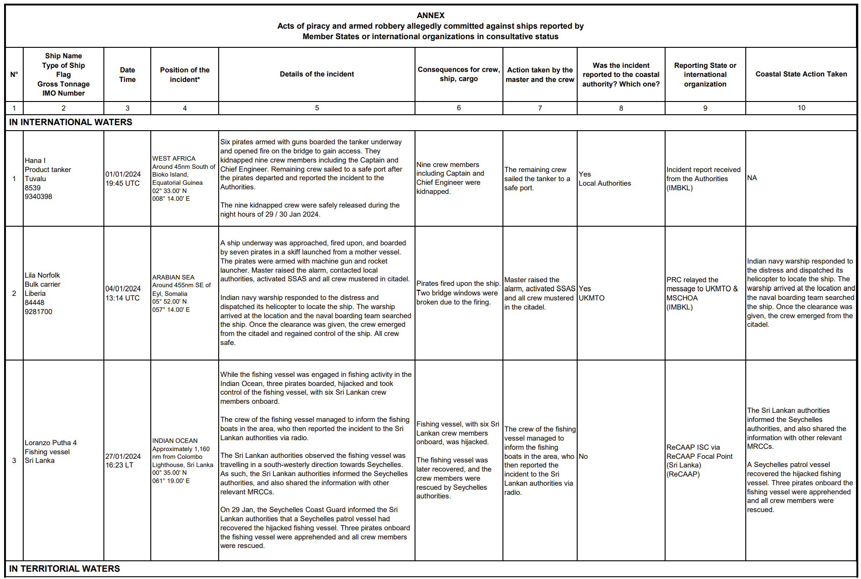
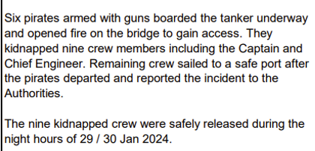
Data Curation

Slide 10

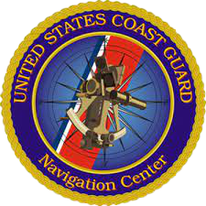






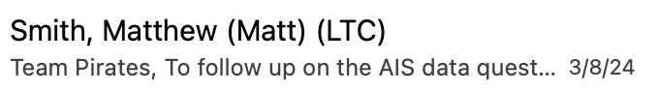





AIS Data
M.S.S.I.S.

Slide 11
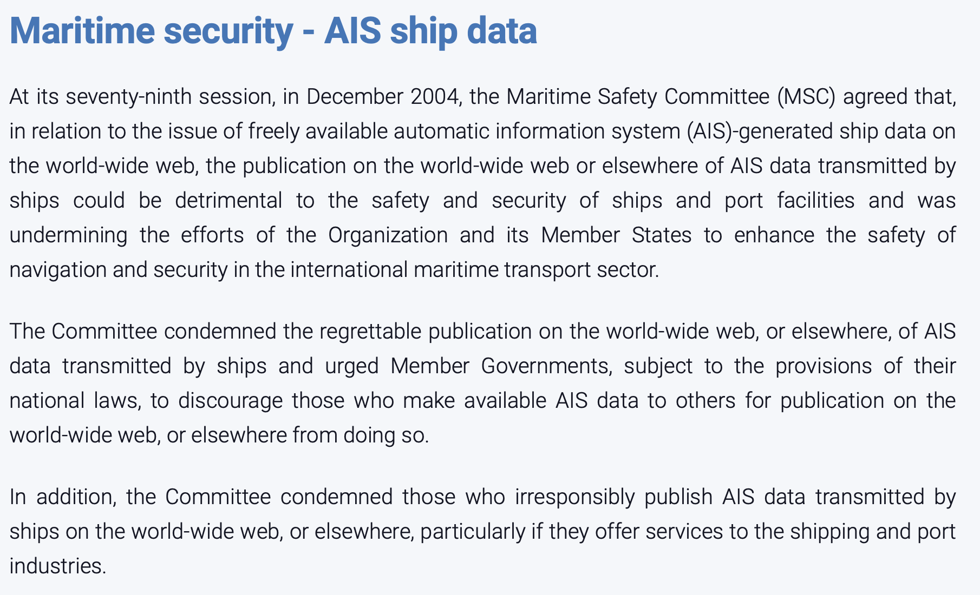
AIS Data
Source: https://www.imo.org/en/OurWork/Safety/Pages/AIS.aspx

Slide 12
Data Curation
Sequential Parallel Lines of Effort
Weather Data
Data Parsing & Cleaning
Data Augmentation
Developing Analytical Techniques
Confirmation of Methodologies
LLM & ML
Comparative Techniques
Categorical Trends

Slide 13
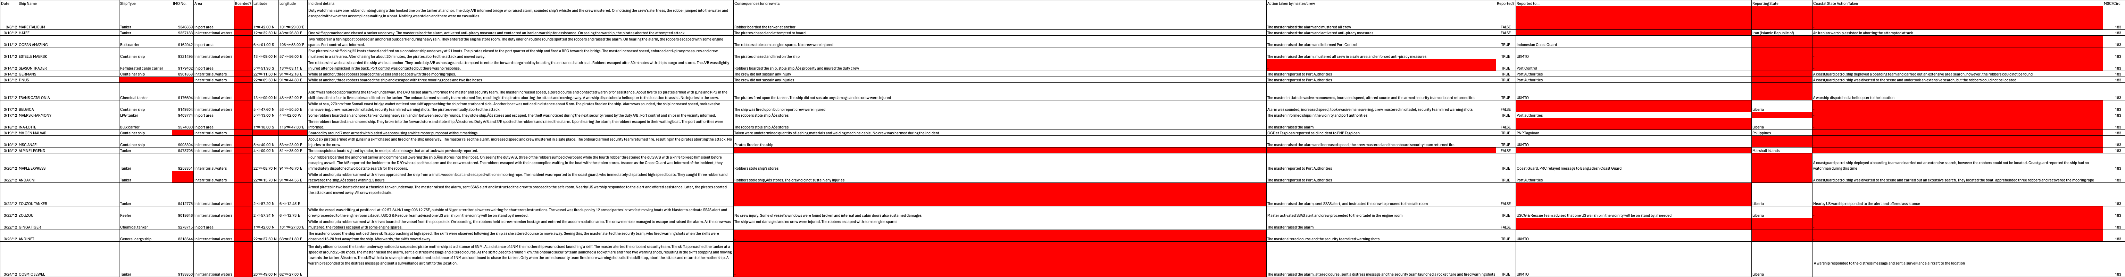
Data Cleaning

Slide 14
Data Cleaning
8,556 rows and 16 columns
19,000 null or missing values
Each row contains a single piracy incident
Little usable data up front
Data we need is in long strings
Natural language (user-input) sentences/paragraphs:
“Incident details”
“Consequences for crew etc”
“Action taken by master/crew”
Not ideal input data

Slide 15
Data Cleaning
Goals:
Ship Flag
IMO Number → ISO2 → Country
Boarded
Natural Language Processing
Hijacked
Natural Language Processing
Consequences to Crew
i.e. injured, held hostage, killed, etc.
Natural Language Processing
All this needs to be parsed out of the strings

Slide 16
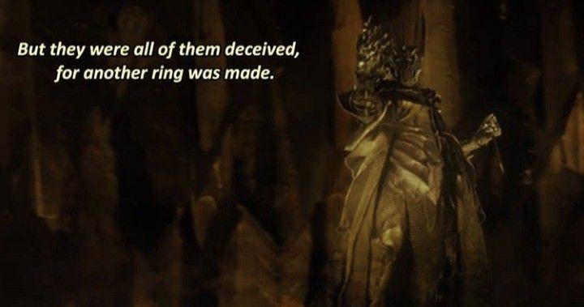
Natural Language Processing: Problem
Three robbers in a boat boarded the ship, while at anchor, broke into ship's stores and when alert crew mustered, they escaped with their loot.
Incident reported to port authority through the local agents. Upon berthing, the police boarded the ship for investigation.
A pirate boat attempted to board the ship while underway.
another 18,000 ways to say ‘boarded’ were made.

Slide 17
Natural Language Processing: Problem
The duty watchman onboard the ship at anchor, noticed robbers trying to open the watertight door to the forecastle store. He immediately alerted the OOW who, in turn, raised the alarm and crew mustered. On seeing crew alertness, the robbers jumped overboard and escaped empty handed in a waiting boat with one accomplice.
Is this a boarding incident?

Slide 18


Natural Language Processing: Problem

Slide 19
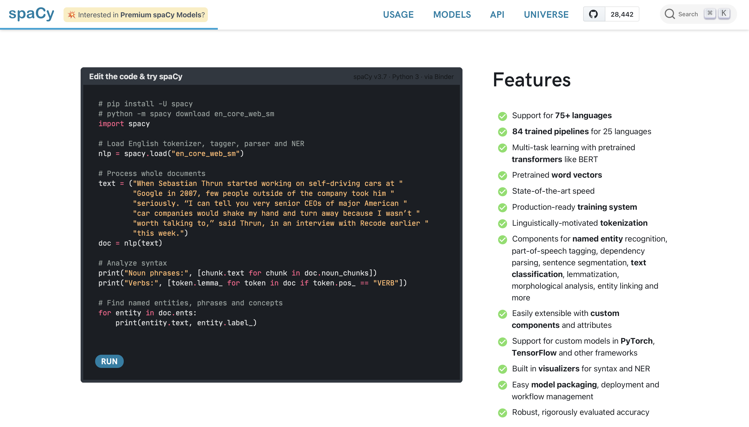
Natural Language Processing: spaCy
Source: https://spacy.io

Slide 20
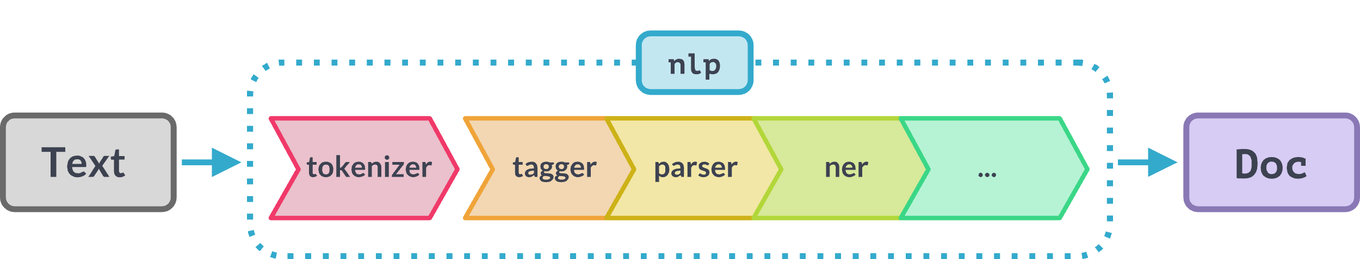
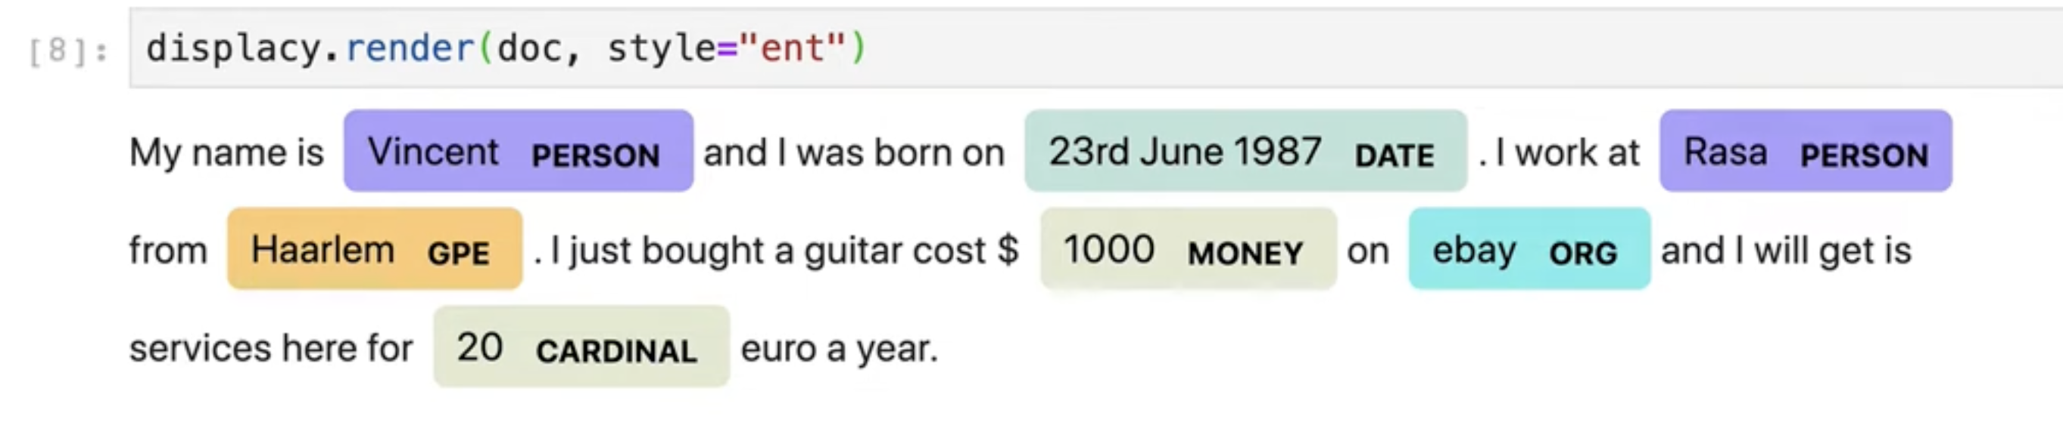
Natural Language Processing: Overview
spancat
Split words into individual tokens
Assign parts of speech to token
Assign grammatical relationships
Named Entity Recognition
Word span categorization
Doc class with attributes

Slide 21
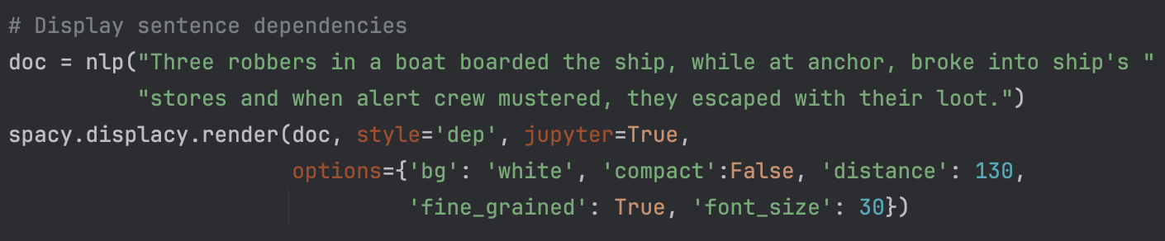
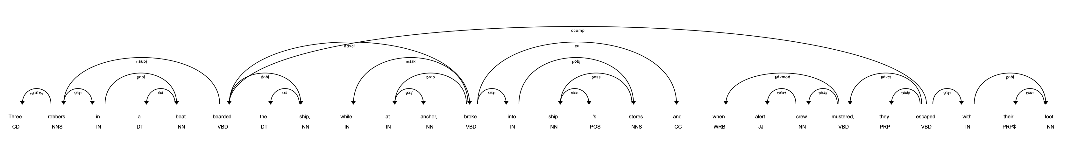
Token-Based Matching

Slide 22
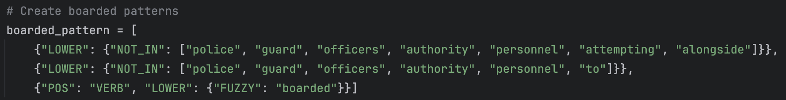
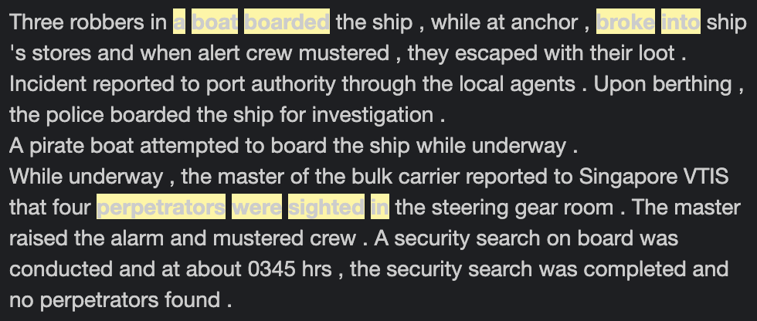
Token-Based Matching
Incident Details: Three robbers in a boat boarded the ship, while at anchor, broke into ship's stores and when alert crew mustered, they escaped with their loot.
Matcher Results: Two matches found.

Slide 23
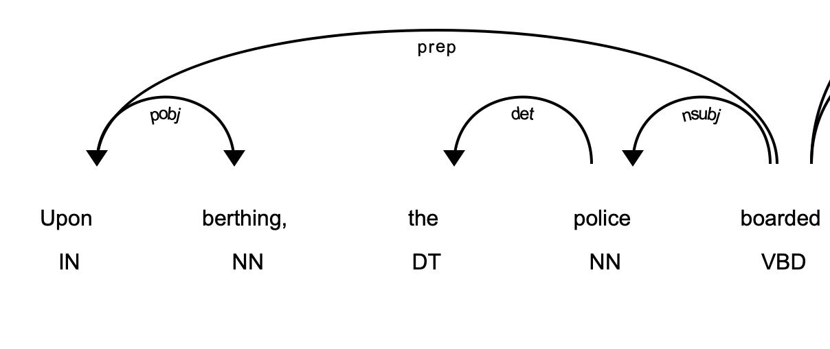
Token-Based Matching
Incident Details: Duty crew onboard the anchored ship noticed the level gauges for the diesel oil tanks lower than normal. The diesel oil tank vent was found damaged with indications of oil being stolen. Incident reported to port authority through the local agents. Upon berthing, the police boarded the ship for investigation.
Matcher Results: No matches found.

Slide 24
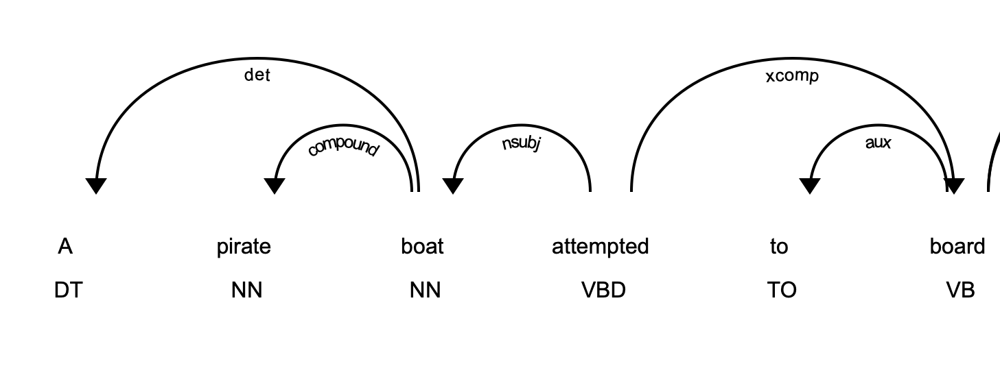
Token-Based Matching
Incident Details: A pirate boat attempted to board the ship while underway.
Matcher Results: No matches found.

Slide 25
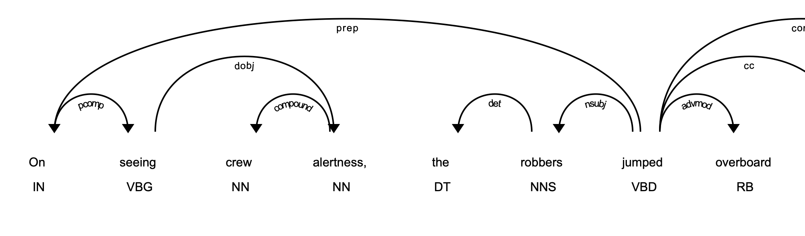
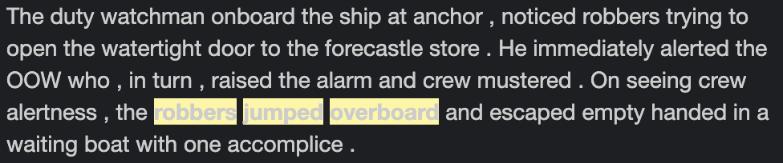
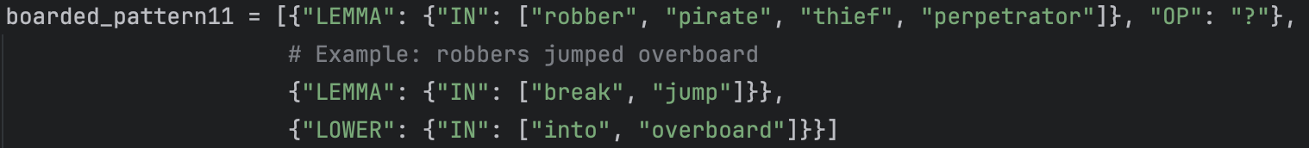
Token-Based Matching
Incident Details: The duty watchman onboard the ship at anchor, noticed robbers trying to open the watertight door to the forecastle store. He immediately alerted the OOW who, in turn, raised the alarm and crew mustered. On seeing crew alertness, the robbers jumped overboard and escaped empty handed in a waiting boat with one accomplice.
Matcher Results: One match found.

Slide 26
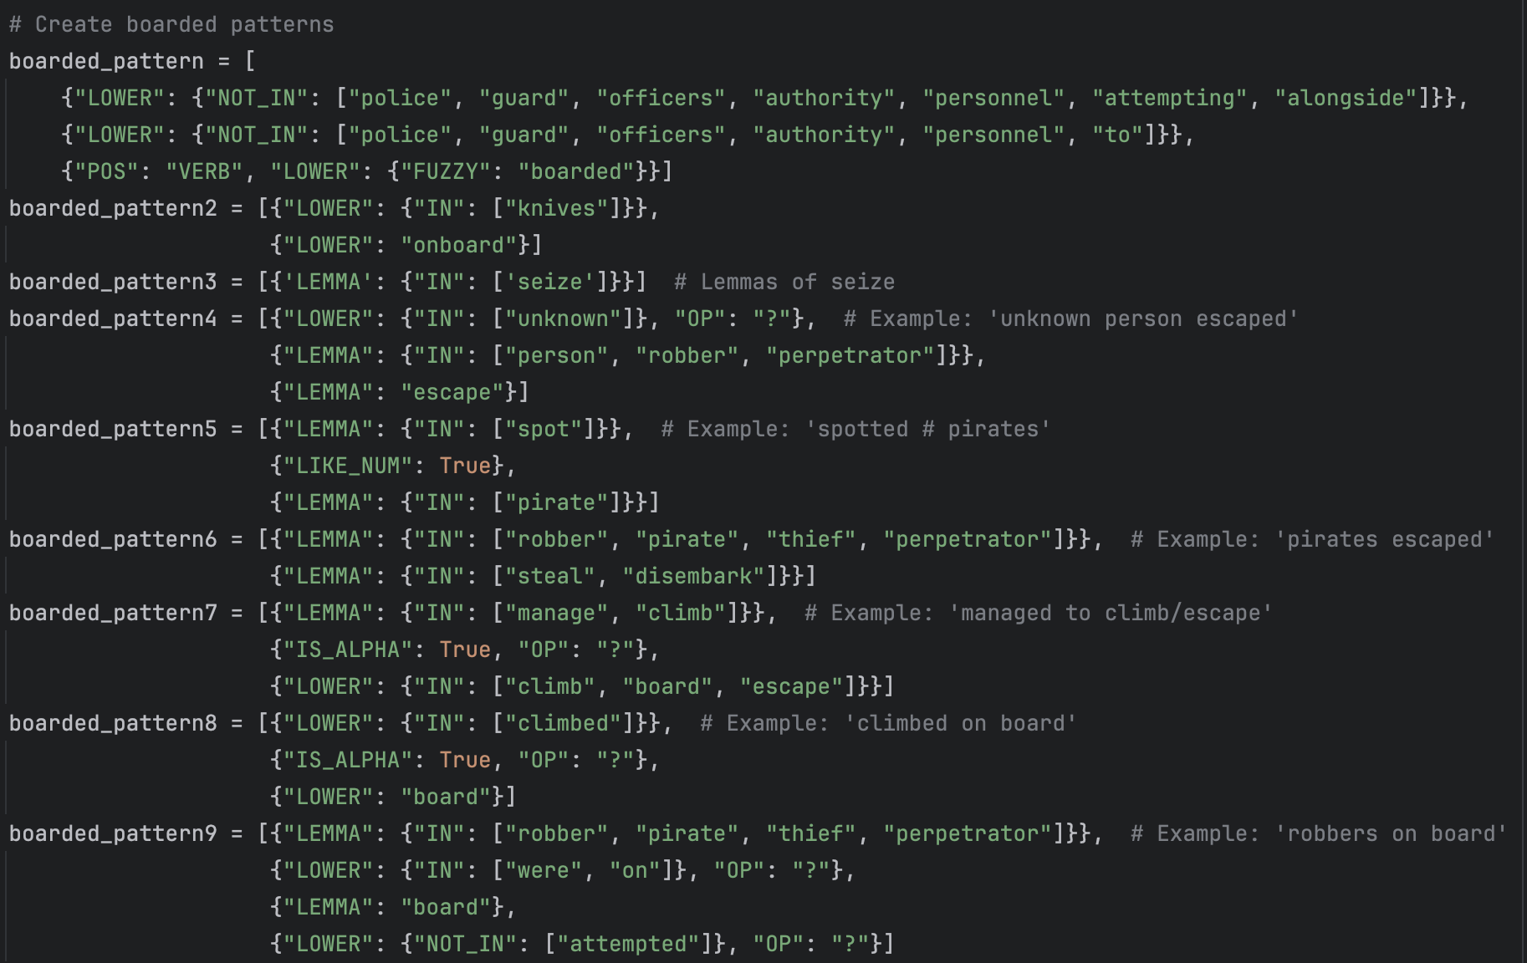
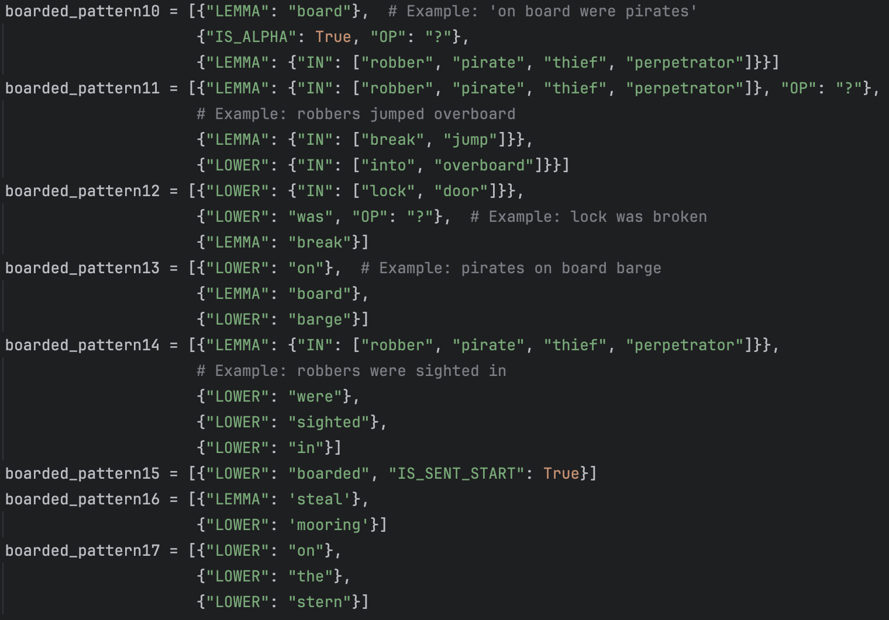
Token-Based Matching
Result: 17 patterns to capture (most) boarding incidents.
Confusion Matrix on Training Data |  | Model
 |  | No match | Match
Actual Values | Not boarded | 171 | 4
 | Boarded | 0 | 325
False Positives

Slide 27
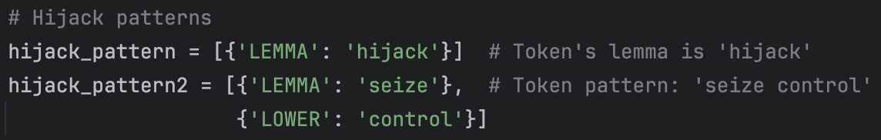
Token-Based Matching
Only two patterns needed to capture (most) hijack incidents.
Confusion Matrix on Training Data |  | Model
 |  | No Match | Match
Actual Values | Not hijacked | 474 | 3
 | Hijacked | 0 | 23
False Positives
Complexity depends on what you want to categorize.

Slide 28
Natural Language Processing: The Process
Rule-Based Matching
Statistical Model
Process Parameters
Worked well with training data.
Did not work well with full dataset.
Use spaCy to generate its own rules based on our self-labelled data.
Use modelled Span Categorizer to label each string.
Conduct Analysis
Find trends in piracy incidents

Slide 29
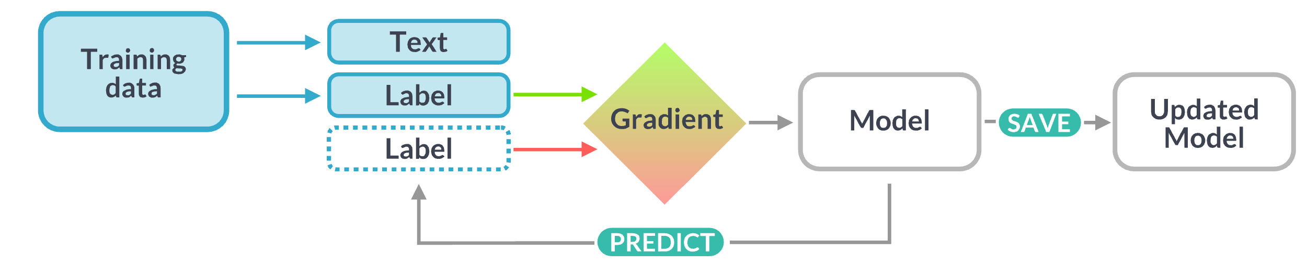
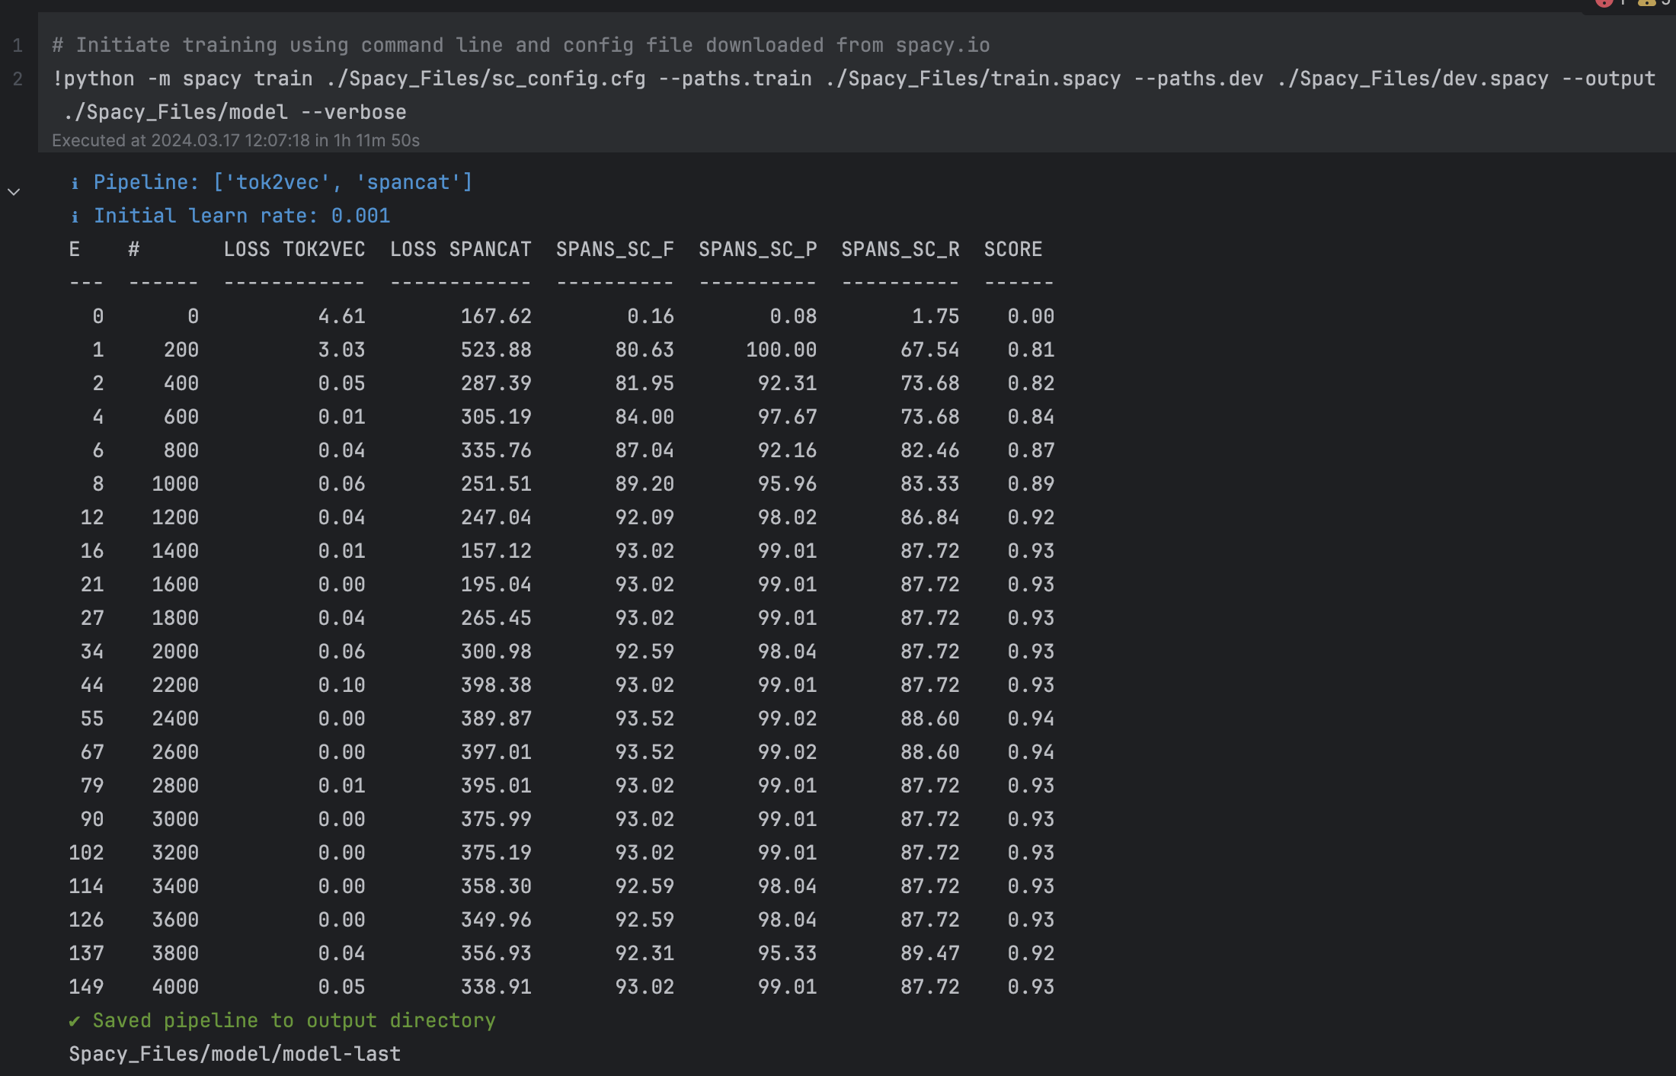
Natural Language Processing: Model
Training data shuffled and split:
75% training data
15% development data
10% testing data
Output:
Custom processing model to detect:
Boarded
Hijacked
Hostages taken
Crew assaulted
1 hour, 11 minutes to train model

Slide 30
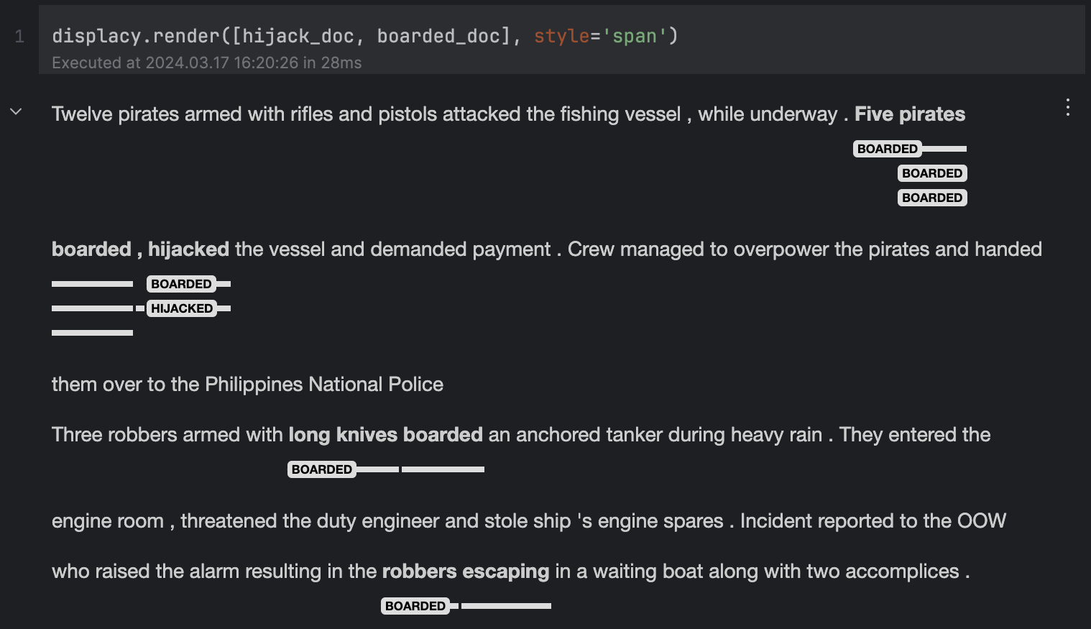
Natural Language Processing: Model
1
Span Labels
2

Slide 31
Natural Language Processing: Performance
Mildly inferior to the Token-Based Matcher on the training data.
Model had better performance on the full dataset.
Token-Based Matching
 |  | Model
 |  | No match | Match
Actual Values | Not boarded | 171 | 4
 | Boarded | 0 | 325
 |  | Model
 |  | No Match | Match
Actual Values | Not hijacked | 474 | 3
 | Hijacked | 0 | 23
Span-Categorizing Model
 |  | Model
 |  | No Match | Match
Actual Values | Not boarded | 173 | 2
 | Boarded | 17 | 308
 |  | Model
 |  | No Match | Match
Actual Values | Not hijacked | 474 | 3
 | Hijacked | 1 | 22

Slide 32
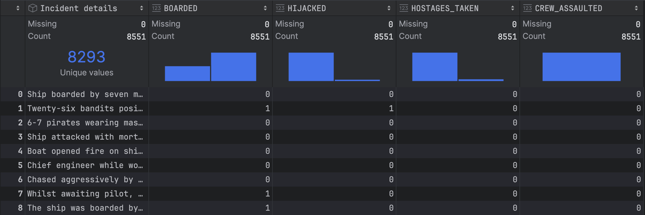
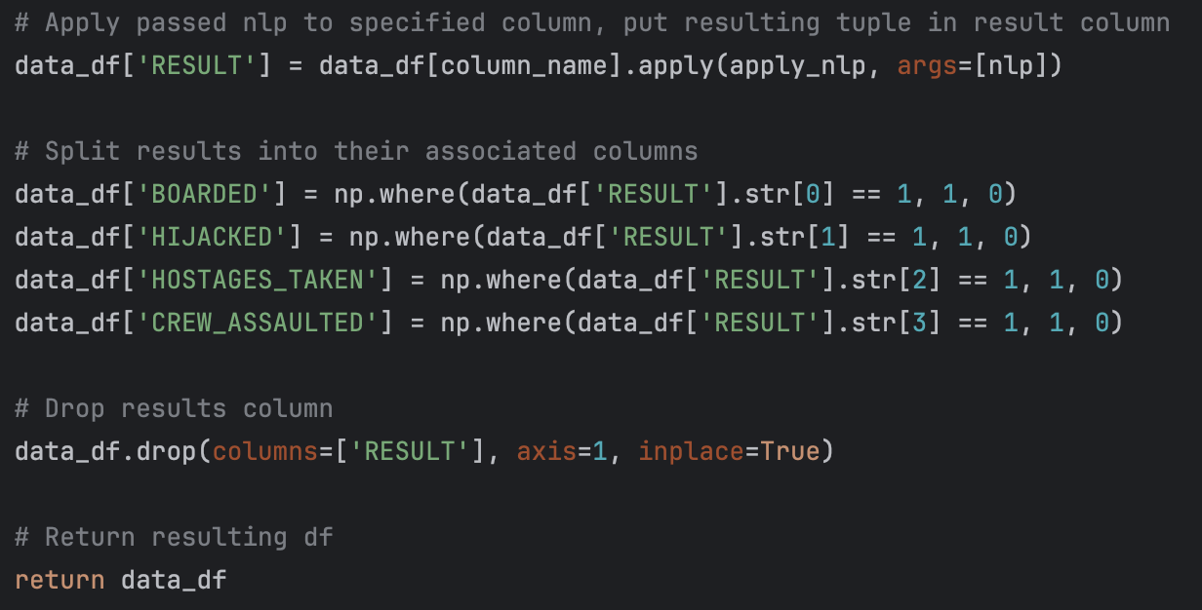
Natural Language Processing: Performance
4.5 minutes to process 8500 rows of data.

Slide 33
Computational Analysis
By using clean data set we produced analytical material to guide further research into underlying trends
Packages utilized: Folium, Matplotlib, Bokeh, Streamlit,

Slide 34
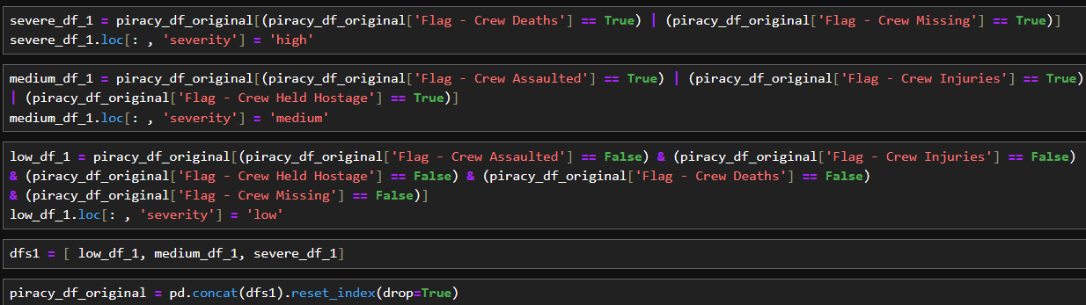
Categorical Analysis
Data Manipulation
1. Created a severity level column based on characteristics of the incident
Notes:
Pull up piracy_map.html

Slide 35
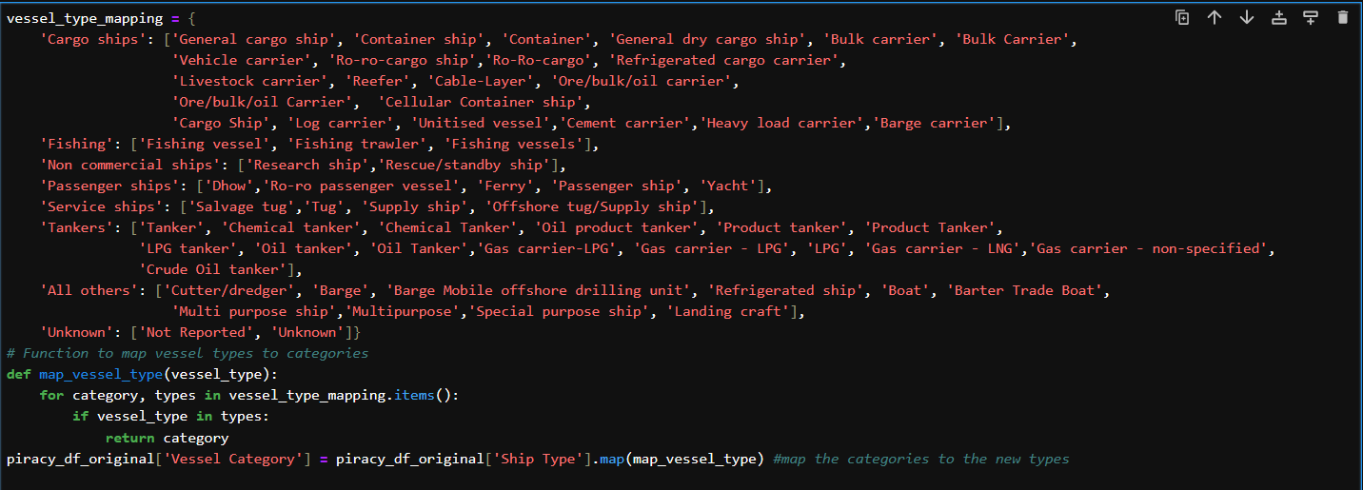
Categorical Analysis
Data Manipulation
2. Simplified Vessel Categories into 8 major categories from 63 types

Slide 36
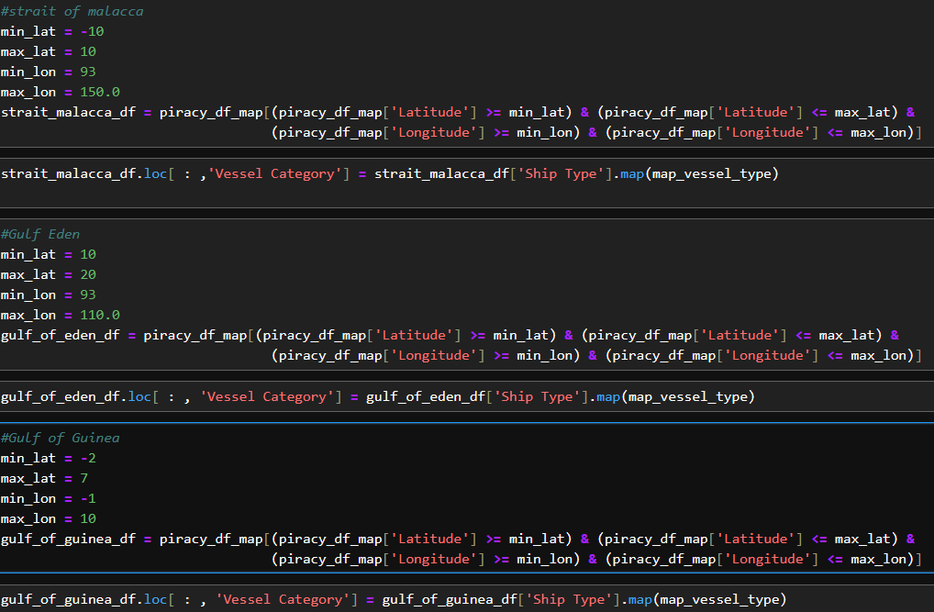
Categorical Analysis
Data Manipulation
3. Created specific data frames based on our areas of interest to conduct comparative analysis and dropped incidents with lat long values.

Slide 37
Categorical Analysis
Within each area of interest, we analyzed:
Ship flags and the associated severity levels | Weapons used and the associated consequences to the crew | Vessel category and the associated consequences to the crew
Assessment: Ship flags that experience the most piracy across the 3 areas of interest are Liberia, Panama , and Singapore | Assessment: Firearm use in more prevalent in the Gulf of Guinea, while knives are more prevalent in the Strait of Malacca. | Assessment: Tankers and then cargo ships have the most recorded incidents across our areas of interest, with the most violence taking place in the Strait of Malacca.
Notes:
Display in the following sequences
severity_tab
Wpns_tab
Vessel_Cat_tab

Slide 38
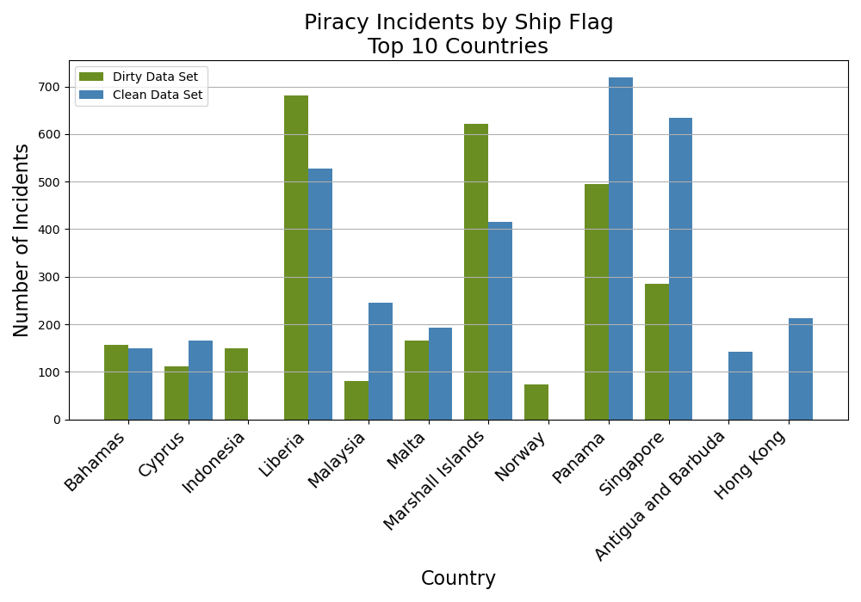
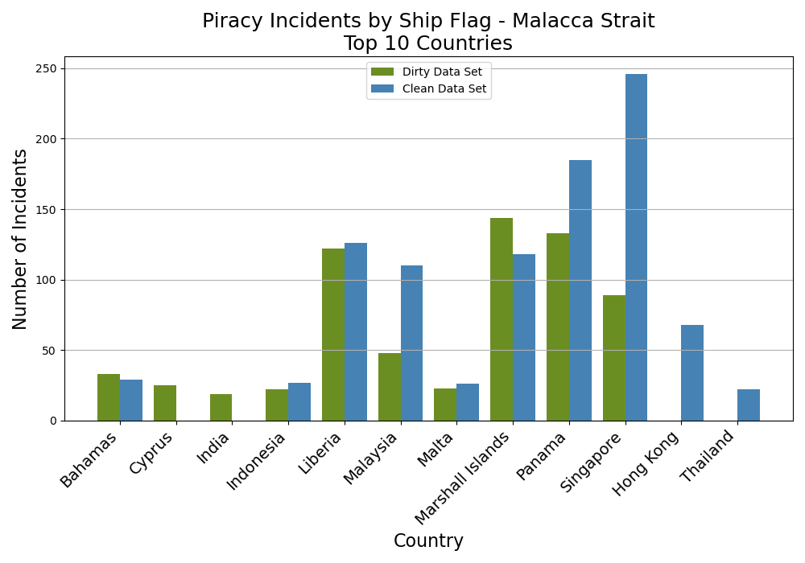
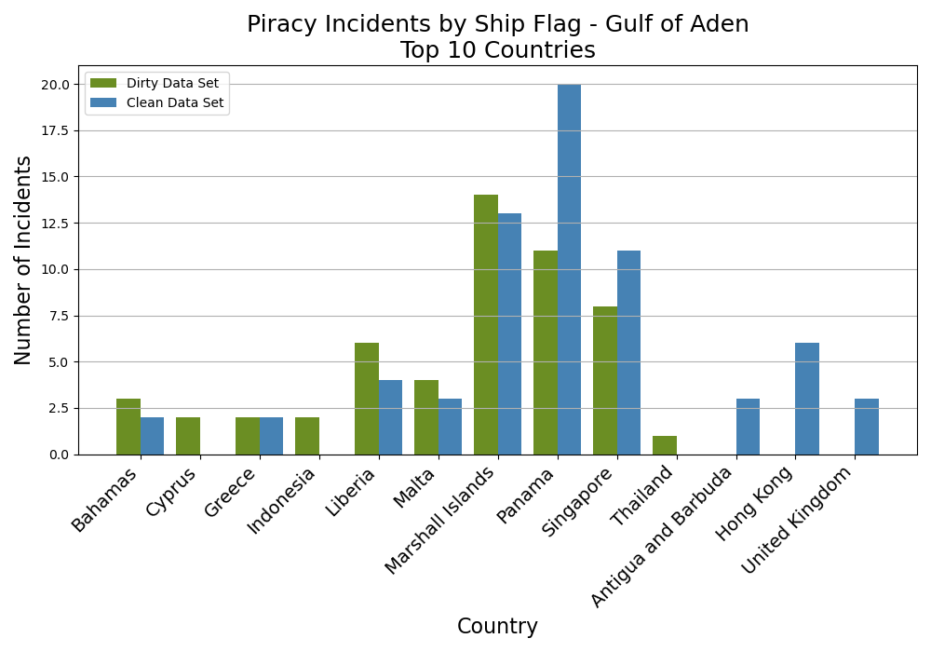
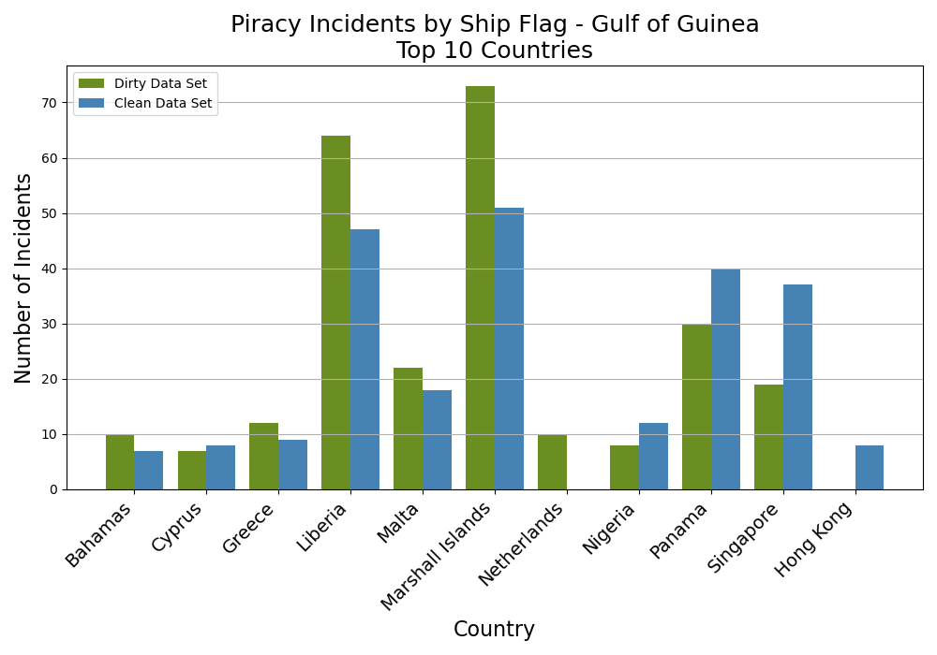
Data Frame Comparison

Slide 39
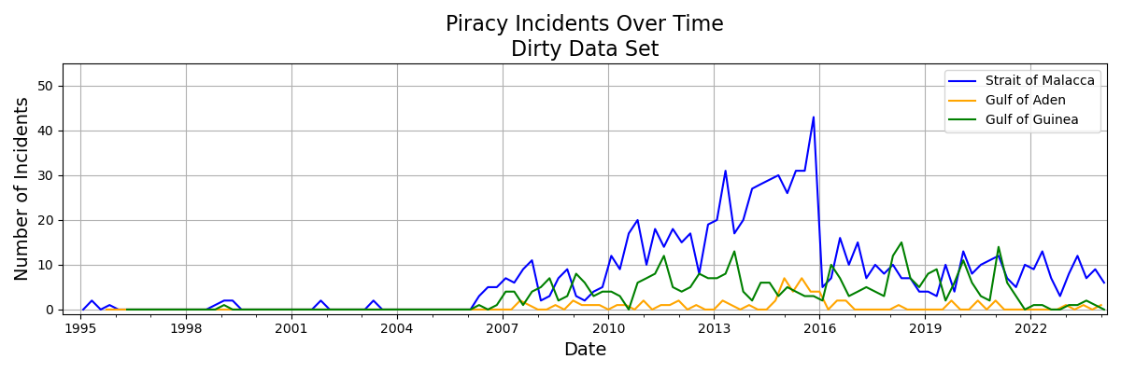
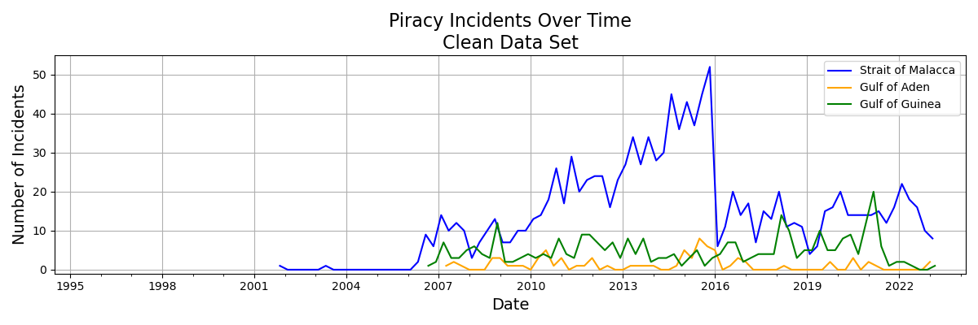
Data Frame Comparison

Slide 40
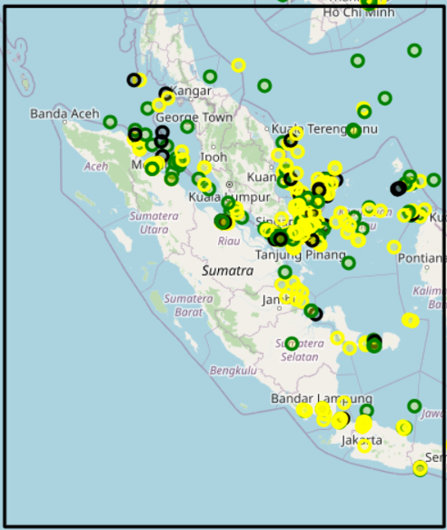
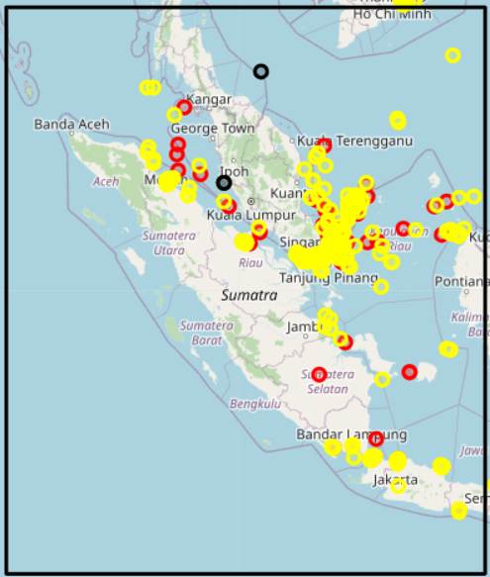
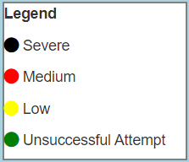
Data Frame Comparison
Malacca Strait
Dirty Data Set
Clean Data Set

Slide 41
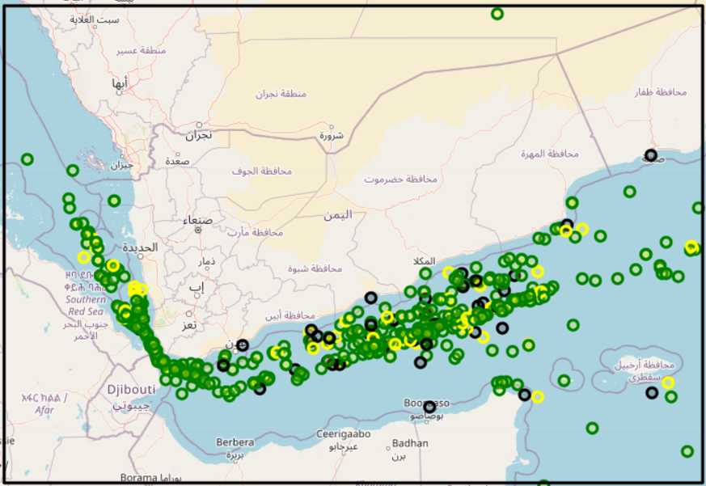

Data Frame Comparison
Gulf of Aden
Dirty Data Set
Clean Data Set

Slide 42


Data Frame Comparison
Gulf of Guinea
Dirty Data Set
Clean Data Set

Slide 43
Lessons Learned / Future Work
Lessons Learned
Natural language entries during data collection
Collaboration tools: GitHub, ReviewNB
Future Work
Augment data frame with environmental data
visibility, sea state, season, etc.
Refine Machine Learning Model
Death
Type of Weapon
Compare piracy trends to AIS data

Slide 44



GitHub Integration
Repository commits
Challenge: GitHub not made for Jupyter Notebooks
Solution: Notebook diff/merge using reviewnb.com
Connects to your GitHub account
Previous version:
Current version:

Slide 45
Lessons Learned / Future Work
Lessons Learned
Natural language entries during data collection
Collaboration tools: GitHub, ReviewNB
Future Work
Augment data frame with environmental data
visibility, sea state, season, etc.
Refine Machine Learning Model
Death
Type of Weapon
Compare piracy trends to AIS data

Slide 46


Data Augmentation
Copernicus Marine Data Store

Slide 47




Data Augmentation
Network Common Data Format (netCDF)
Notes:
https://pro.arcgis.com/en/pro-app/3.1/help/data/imagery/fundamentals-of-netcdf.htm#:~:text=time%20and%20altitude-,Basic%20components%20of%20a%20netCDF%20file,in%20an%20array%2Doriented%20dataset.

Slide 48

Data Augmentation
Methodology for handling huge dataset and data that might not match exactly (Lat/Lon/Time readings)
Apply a function to create smaller subsets of data bounding the known events via tunable buffers and extract the nearest datapoints.
Known Piracy Event
Lon
Lat
Time

Slide 49


Data Augmentation
f
145 entries within the 2021-2024 dataset: Concept can be applied to other datasets that utilize netCDF (future work)

Slide 50
Outline
Problem Framing
Data Curation
Data Cleaning
Natural Language Processing
Computational and Categorical Analysis
Data Frame Comparison
Lessons Learned and Future Work
Notes:
Problem Framing / Data Curation: (person)
What we were looking to find
The data we found and how disgusting it was when we got it straight from IMO
Challenges finding AIS data
Natural Language Processing: (Deryk)
I can talk about this for about 10 minutes
Geospatial Analysis (or whatever we end up doing): (person)
Pretty maps with overly assumptious word pictures.
Conclusions: (person)
Whatever we found
Don't allow people to write their own sentences in surveys

Slide 51
Questions?

Slide 52

Other Slides
Boarded false positives

Slide 53

Other Slides
Model evaluation

Slide 54

Problem Framing
Significance:
Main shipping zone for African Resources to rest of world
Trade Volume:
25% African Maritime traffic
1500 Ships daily
Facts :
Est $1.925 billion lost annually in direct and indirect costs due to piracy
Gulf of Guinea
N
100 NM
Notes:
https://www.securitycouncilreport.org/monthly-forecast/2022-11/gulf-of-guinea-piracy.php
Stable Seas estimated that ransom payments to Gulf of Guinea pirate gangs generated approximately $5 million annually.
https://www.scirp.org/journal/paperinformation?paperid=78135#:~:text=However%2C%20this%20region%20is%20riddled,on%20maritime%20transportation%20and%20security.

Slide 55
Problem Framing
Significance:
Critical gateway between Pacific and Indian Oceans
Trade Volume:
$3.5 trillion annually
30% of Worldwide Trade
94k+ Ships annually
Facts:
2/3 CHN Maritime Trade
80% CHN Oil Imports Transit
Strait of Malacca
N
100 NM
Notes:
Image from: https://www.cambridge.org/core/journals/journal-of-navigation/article/abs/mapping-global-shipping-density-from-ais-data/AF6BE98CFFDE5D8E7C7466A708F4E7D1
https://www.marineinsight.com/environment/malacca-strait/
Sources:
https://www.ismworld.org/supply-management-news-and-reports/news-publications/inside-supply-management-magazine/blog/2023/2023-11/the-strait-of-malaccas-global-supply-chain-implications/#:~:text=The%20volume%20of%20trade%20that,third%20of%20all%20worldwide%20trade.

Slide 56
Problem Framing
Significance:
Main shipping zone for African Resources to rest of world
Trade Volume:
25% African Maritime traffic
1500 Ships daily
Facts :
Est $1.925 billion lost annually in direct and indirect costs due to piracy
Gulf of Guinea
N
100 NM
Notes:
https://www.securitycouncilreport.org/monthly-forecast/2022-11/gulf-of-guinea-piracy.php
Stable Seas estimated that ransom payments to Gulf of Guinea pirate gangs generated approximately $5 million annually.
https://www.scirp.org/journal/paperinformation?paperid=78135#:~:text=However%2C%20this%20region%20is%20riddled,on%20maritime%20transportation%20and%20security.

